Slide 1
Face classifier -by fy_rocks
Detect person’s age and gender

Slide 2
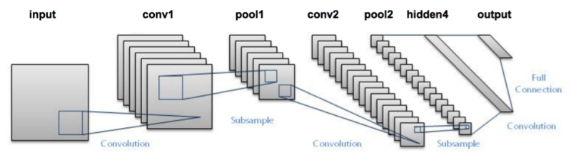
Face classifier
Predict age, gender in real-time with built-in webcam of laptop.
Predict age, gender from any directory or any particular image.
Can save predicted data in csv or json file format.
Can show images with data and detected faces.
Trained more than 100k+ images of celebrities
Convolutional Neural Network

Slide 3
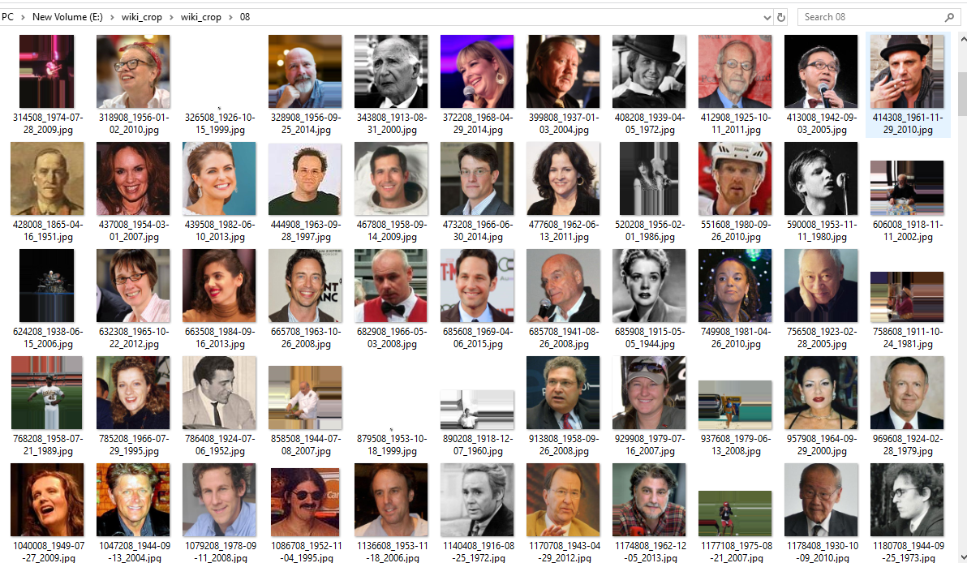
In total we obtained 460,723 face images from 20,284 celebrities from IMDb and 62,328 from Wikipedia, thus 523,051 in total.

Slide 4
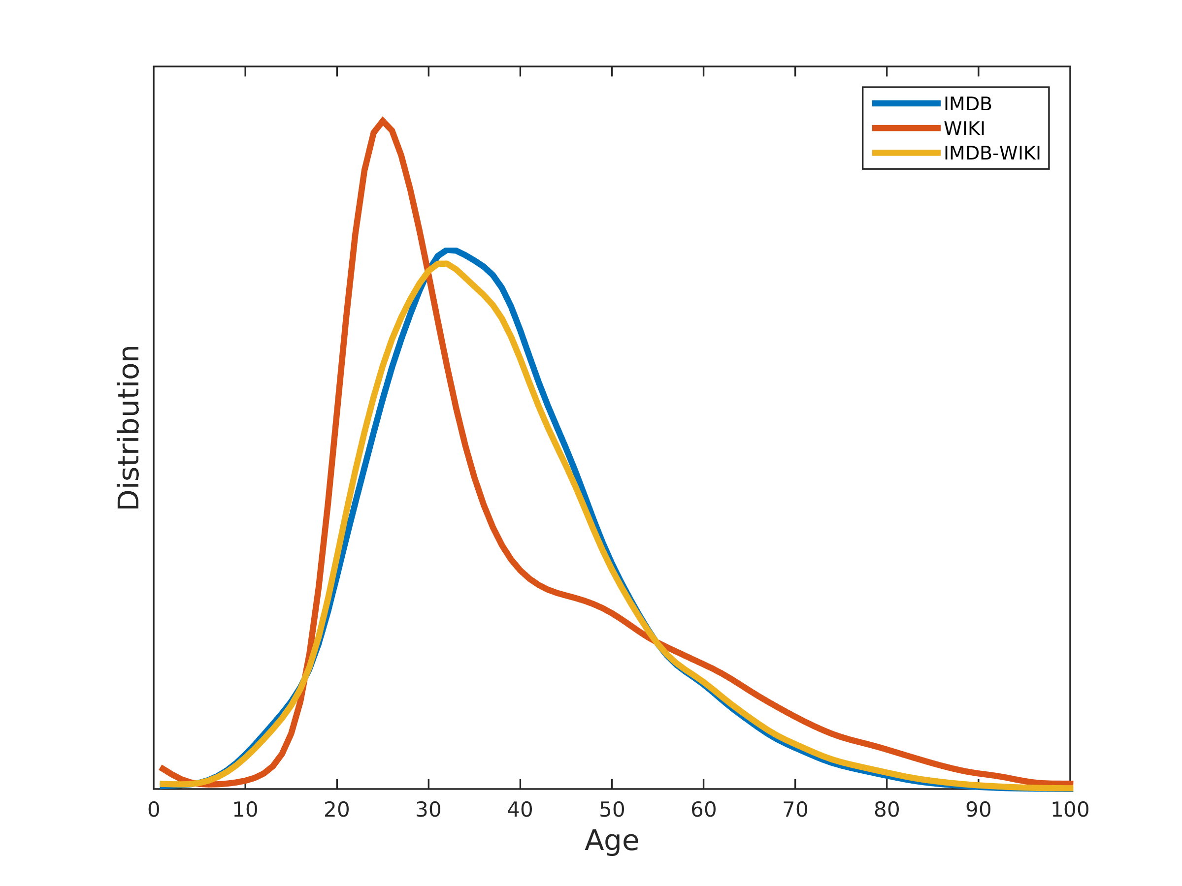
Dataset

Slide 5
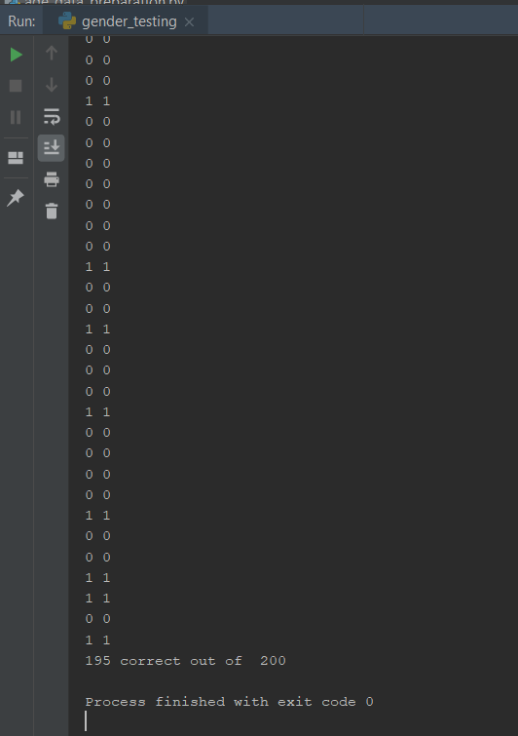
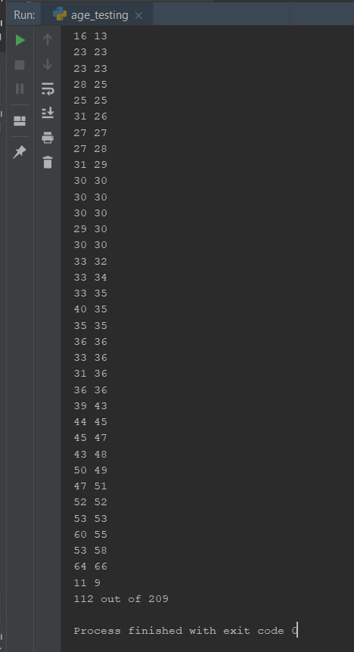
With prediction
of +- 5 years

Slide 6
